Slide 1


VI International Conference
«Fundamental Bases of Mechanochemical Technologies»
«FBMT 2022»
November 21 - 24, 2022
Novosibirsk, Russia

Slide 2

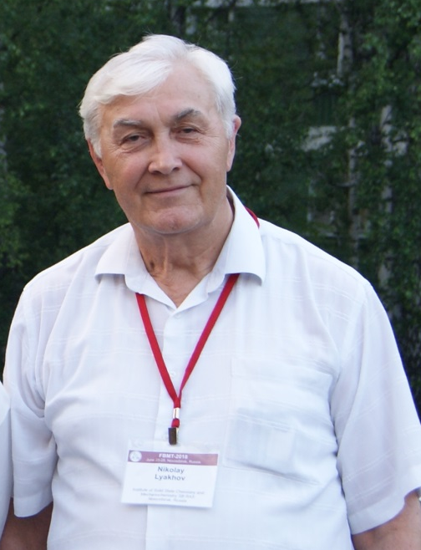



VI FBMT
November 21 - 24, 2022
Novosibirsk, Russia
VI International Conference
“Fundamental Bases of
Mechanochemical Technologies”
ORGANIZER OF THE CONFERENCE
Institute of Solid State Chemistry and Mechanochemistry SB RAS
CO-ORGANIZERS OF THE CONFERENCE
Dalian Jiaotong University, China
Science and Technology Society of Guangdong Province, China
Academic Exchange Information Center (AEIC), China
Prof. N. Lyakhov
Prof. Gao Hong

Slide 3
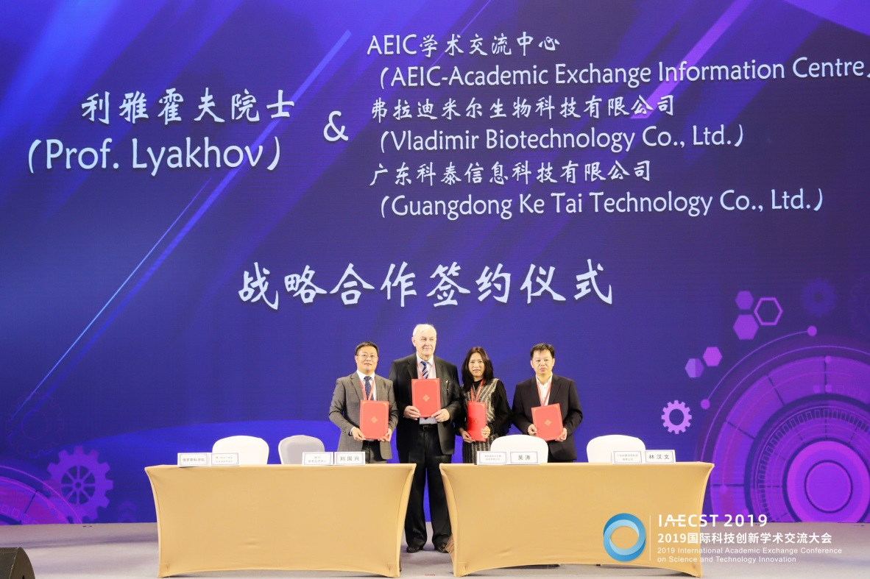
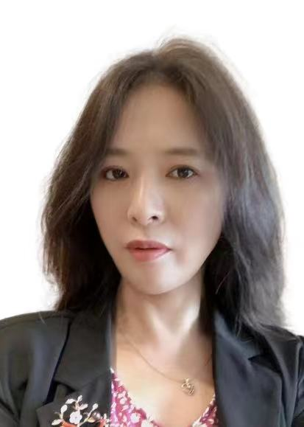

VI FBMT
November 21 - 24, 2022
Novosibirsk, Russia
VI International Conference
“Fundamental Bases of
Mechanochemical Technologies”
SPONSORS
Ms. Wu Tao
Dongguan Fenghuolun Thermal Technology Co., Ltd., China
Guangdong Dongguan Vladimir Co., Ltd., China

Slide 4
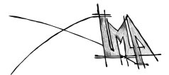
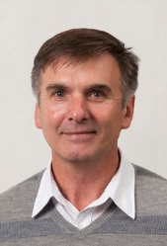
VI FBMT
November 21 - 24, 2022
Novosibirsk, Russia
VI International Conference
“Fundamental Bases of
Mechanochemical Technologies”
The conference is organized under the auspices
International Mechanochemical Association (IMA)
http://imamechanochemical.com/
President Prof. Vladimir Šepelák

Slide 5
VI FBMT
November 21 - 24, 2022
Novosibirsk, Russia
VI International Conference
“Fundamental Bases of
Mechanochemical Technologies”
Number of participants – 173
Number of presentations – 103
Number of young participants - 47
Number of participating countries - 10

Slide 6










VI FBMT
November 21 - 24, 2022
Novosibirsk, Russia
VI International Conference
“Fundamental Bases of
Mechanochemical Technologies”
Participating countries - number of participants:
Russia - 127
China – 30
Brazil - 6
France - 2
Belarus - 2
Kazakhstan – 2
Germany - 1
India - 1
Japan -1
United Kingdom-1

Slide 7
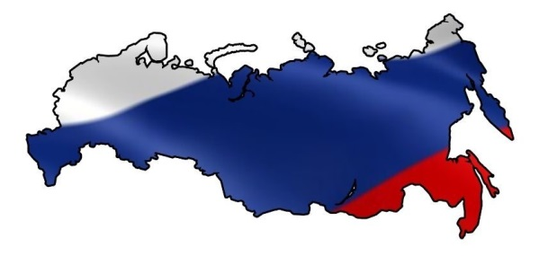
VI FBMT
November 21 - 24, 2022
Novosibirsk, Russia
VI International Conference
“Fundamental Bases of
Mechanochemical Technologies”
Russian cities participants:
City | Number of participants
Novosibirsk | 82
Moscow | 17
Tomsk | 7
Apatity | 6
Ivanovo | 3
Krasnoyarsk | 2
Chernogolovka | 2
City | Number of participants
Chelyabinsk | 2
Irkutsk | 2
Izhevsk | 1
Barnaul | 1
Omsk | 1
Ufa | 1
Novocherkassk | 1

Slide 8
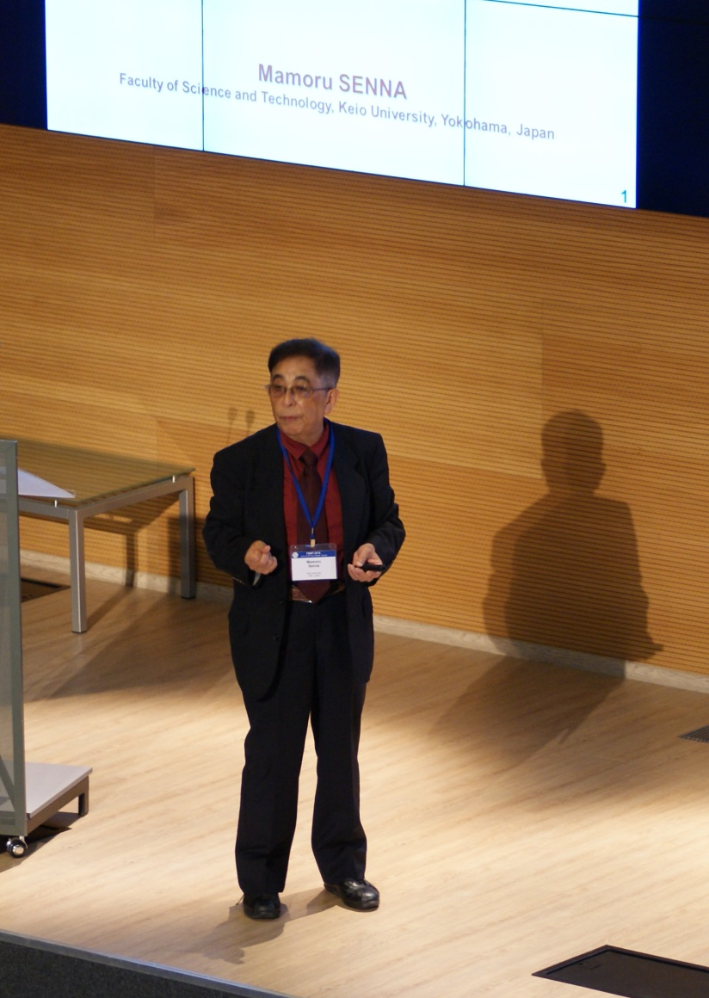
VI FBMT
November 21 - 24, 2022
Novosibirsk, Russia
VI International Conference
“Fundamental Bases of
Mechanochemical Technologies”
Permanent participant of all FBMT conferences
FBMT-2001
FBMT-2004
FBMT-2013
FBMT-2015
FBMT-2018
Prof. M. Senna
FBMT-2022

Slide 9
VI FBMT
November 21 - 24, 2022
Novosibirsk, Russia
VI International Conference
“Fundamental Bases of
Mechanochemical Technologies”
Foreign organizations:
Al-Farabi Kazakh National University (Kazakhstan)
Beijing Institute of Technology (China)
CSIR-National Metallurgical Laboratory (India)
Dalian Jiaotong University (China)
Ecole Centrale de Lyon, Laboratory LTDS (France)
Federal University of São Carlos (Brazil)
Guangxi Yuchai Machinery Co, Ltd (China)
Indian Institute of Technology (Indian School of Mines) (India)
Institute of Nanotechnology, Karlsruhe Institute of Technology (Germany)
Jilin Academy of Agricultural Sciences (China)
Joint Institute of Mechanical Engineering (Belarus)
Keio University (Japan)
LEPMI - Grenoble INP (France)
Nanning Normal University (China)
Northeastern University (China)
S. Amanzholov East Kazakhstan University (Kazakhstan)
School of Aerospace, Transport and Manufacturing, Cranfield University (UK)
Yanka Kupala State University of Grodno (Belarus)
Zhejiang University of Technology (China)

Slide 10
VI FBMT
November 21 - 24, 2022
Novosibirsk, Russia
VI International Conference
“Fundamental Bases of
Mechanochemical Technologies”
Scientific Institutes (Russia):
A.E. Favorsky Irkutsk Institute of Chemistry of the SB RAS
A.N. Frumkin Institute of Physical Chemistry and Electrochemistry RAS
A.N. Nesmeyanov Institute of Organoelement Compounds RAS
Center of New Chemical Technologies BIC Boreskov Institute of Catalysis
Enikolopov Institute of Synthetic Polymeric Materials RAS
Federal Research Center Boreskov Institute of Catalysis SB RAS
G.A. Krestov Institute of Solution Chemistry RAS
Institute of Chemistry and Chemical Technology SB RAS FRC "Krasnoyarsk Scientific Center SB RAS"
Institute of Solid State Chemistry and Mechanochemistry SB RAS
Institute of Strength Physics and Materials Science SB RAS
Khristianovich Institute of Theoretical and Applied Mechanics SB RAS
Lavrentyev Institute of Hydrodynamics SB RAS
Merzhanov Institute of Structural Macrokinetics and Materials Science RAS
Tananaev Institute of Chemistry - Subdivision of the Federal Research Centre «Kola Science Centre of the Russian Academy of Sciences»
Tomsk Scientific Center SB RAS
Udmurt Federal Research Center UB RAS
V.S. Sobolev Institute of Geology and Mineralogy SB RAS

Slide 11
VI FBMT
November 21 - 24, 2022
Novosibirsk, Russia
VI International Conference
“Fundamental Bases of
Mechanochemical Technologies”
Universities (Russia) :
1. Bashkir State University
2. Chelyabinsk State University
3. Far Eastern Federal University
4. Irkutsk State Transport University
5. Ivanovo State University of Chemistry and Technology
6. M.V. Lomonosov Moscow State University Department of Physics
7. National Research Tomsk Polytechnical University
8. National University of Science and Technology “MISIS”
9. Novosibirsk State Technical University
10. Novosibirsk State University
11. Peoples Friendship University of Russia
12. Polzunov Altai State Technical University
13. Siberian Federal University
14. Volgograd State Technical University
15. Yuri Gagarin State Technical University of Saratov

Slide 12
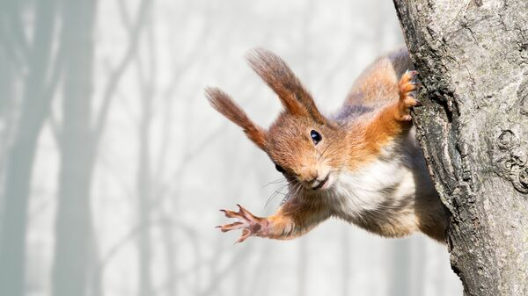
VI FBMT
November 21 - 24, 2022
Novosibirsk, Russia
VI International Conference
“Fundamental Bases of
Mechanochemical Technologies”
See you soon at FBMT-2025!

